Slide 1
Welcome
To
Project - 2
Capstone- Project
Amazon brand products within the e-commerce domain
Name – Mohd Jubair Khan
Date – 15 – 12 - 2024

Slide 2
Abstract
This project analyzes sentiment in over 34,000 customer reviews for Amazon products, categorized into positive, negative, and neutral sentiments. It aims to build a robust sentiment analysis model by addressing class imbalance, implementing traditional machine learning classifiers like Naive Bayes, and exploring advanced techniques such as Support Vector Machines (SVM), LSTM networks, and ensemble methods like XGBoost.
The project focuses on:
1. Data Exploration: Insights into review patterns and sentiment distribution.
2. Feature Engineering: Transforming text into meaningful numerical representations using TF-IDF.
3. Class Imbalance Handling: Applying oversampling and under-sampling techniques.
4. Model Optimization: Employing techniques like Grid Search and Cross-Validation.
5. Topic Modeling: Clustering reviews to uncover latent topics using LDA and NMF.
Performance evaluation metrics, including precision, recall, F1-score, and AUC-ROC, demonstrated the effectiveness of these approaches. The project highlights the potential of sentiment analysis in enhancing customer feedback understanding and improving e-commerce strategies.

Slide 3
Content
1. Introduction
2. Objectives
3. Methods
4. Results
5. Conclusions
Chapter - 1
1. Introduction
In the age of e-commerce, customer reviews play a critical role in shaping consumer decisions and influencing product development. These reviews, often containing detailed opinions about product features, performance, and overall satisfaction, provide a rich source of unstructured data that can be analyzed to uncover valuable insights. However, analyzing thousands of reviews manually is both time-consuming and prone to bias. This project leverages the power of natural language processing (NLP) to automate the analysis of over 34,000 Amazon product reviews, focusing on two complementary tasks: sentiment analysis and topic modeling. The primary goal of this project is to classify customer reviews into sentiment categories (positive, negative, and neutral) and to identify latent topics discussed in the reviews. Sentiment analysis is performed using traditional machine learning algorithms, such as Naive Bayes and Support Vector Machines (SVM), as well as deep learning models like Long Short-Term Memory (LSTM) networks. Additionally, topic modeling techniques, including Latent Dirichlet Allocation (LDA) and Non-Negative Matrix Factorization (NMF), are applied to group reviews based on underlying themes.

Slide 4
Chapter - 2
2. Objectives:
The primary objectives of this project are as follows:
Understand Sentiment in Customer Reviews: Analyze over 34,000 Amazon product reviews to classify sentiments into three categories: positive, negative, and neutral. Extract insights about customer satisfaction and dissatisfaction.
2. Address Class Imbalance: Handle the issue of class imbalance in sentiment categories using techniques such as oversampling and under-sampling to ensure fair representation of all classes.
3. Implement Effective Classifiers: Evaluate and compare various machine learning algorithms, including Naive Bayes, Support Vector Machines (SVM), and deep learning models like Long Short-Term Memory (LSTM) networks for sentiment classification.

Slide 5
4. Enhance Predictive Power through Feature Engineering: Perform feature engineering, including the computation of Term Frequency-Inverse Document Frequency (Tf-Idf) scores and the creation of sentiment score features to improve model accuracy.
5. Evaluate Model Performance: Use metrics such as precision, recall, F1-score, and AUC-ROC to measure model performance, emphasizing the F1-score for balanced evaluation in the presence of class imbalance.
6. Leverage Ensemble Techniques: Explore ensemble methods, such as XGBoost and combinations with multinomial Naive Bayes, to boost overall model performance and mitigate class imbalance.
7. Incorporate Topic Modeling: Apply techniques such as Latent Dirichlet Allocation (LDA) and Non-Negative Matrix Factorization (NMF) to identify latent topics in reviews and group them into meaningful clusters.
8. Compare Traditional and Advanced Models: Contrast the performance of traditional machine learning models with advanced deep learning approaches, such as LSTM, to determine the most effective model for sentiment analysis.

Slide 6
9. Optimize Model Parameters: Use optimization techniques, including Grid Search, Random Search, and Cross-Validation, to fine-tune parameters for improved model performance.
10. Generate Actionable Insights: Provide actionable insights for e-commerce businesses by identifying customer preferences, concerns, and satisfaction levels, thereby enabling data-driven decision-making and targeted marketing strategies.

Slide 7
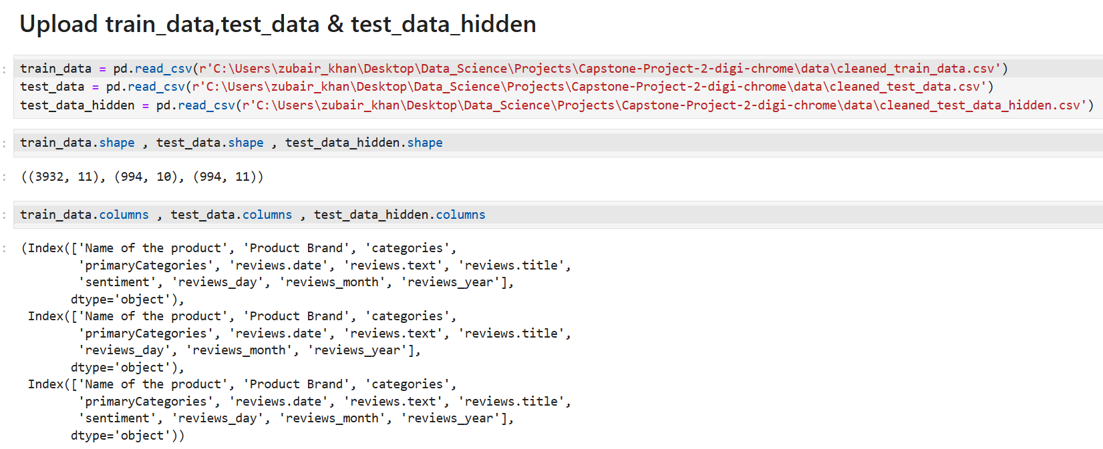
Chapter - 3
3. Methods
(i). Data Collection and Preprocessing:
* Dataset Overview: The dataset comprises over 34,000 Amazon product reviews, with attributes such as product name, brand, category, review text, review title, and sentiment labels (positive, negative, neutral).

Slide 8
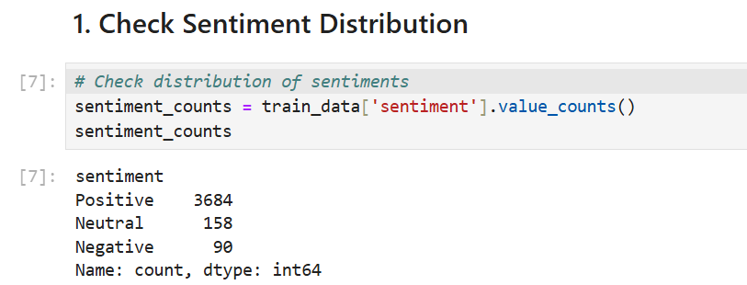
* Preprocessing Steps:
1. Convert text to lowercase for uniformity.
2. Remove special characters, punctuation, and stopwords.
3. Tokenize review text into individual words.
4. Apply stemming and lemmatization to standardize word forms.
(ii). Exploratory Data Analysis (EDA)
* Visualized the distribution of sentiment categories.

Slide 9
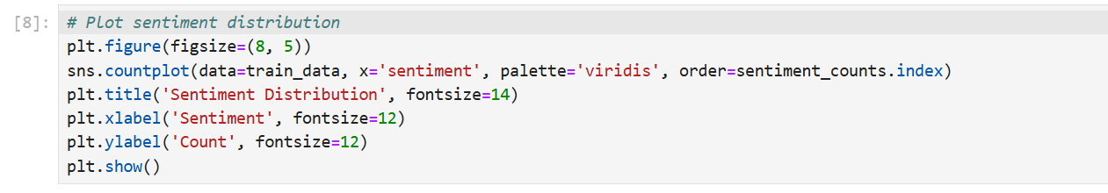
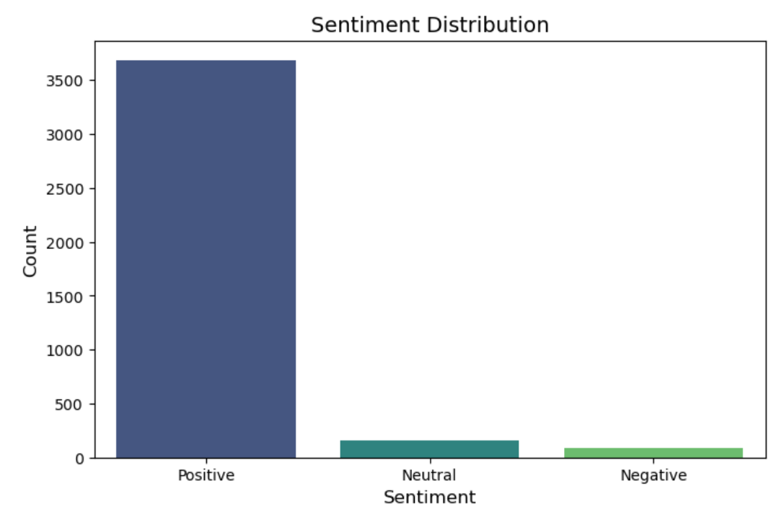

Slide 10
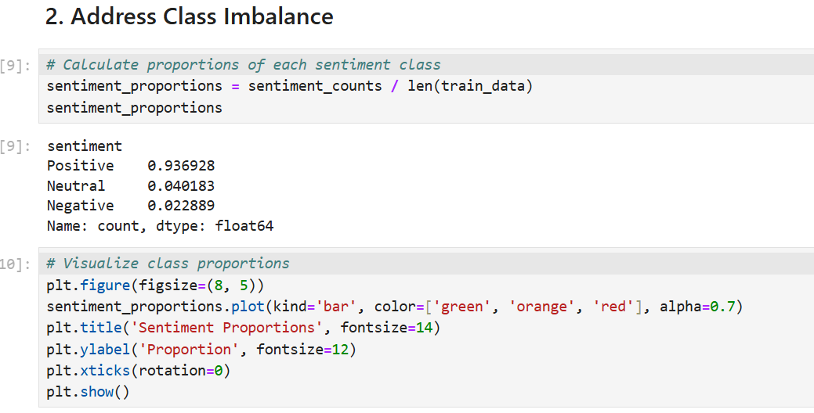
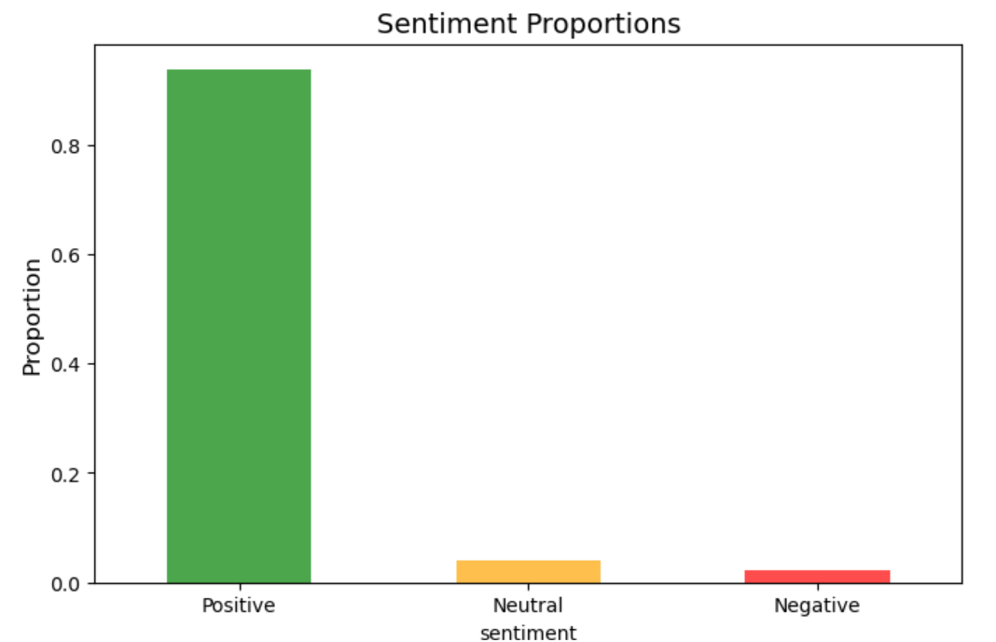
* Identified class imbalance issues and trends in the data.

Slide 11
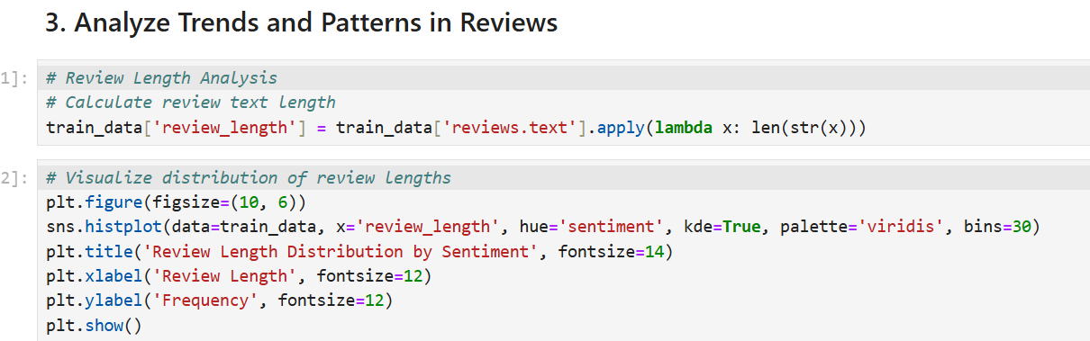
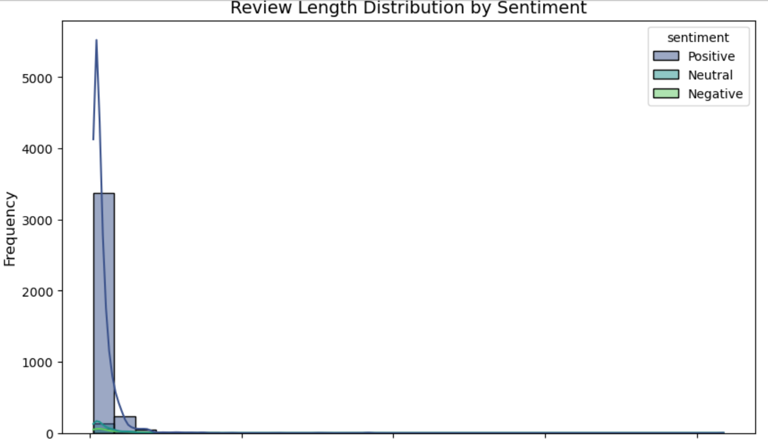
* Examined review patterns across product categories and brands.

Slide 12
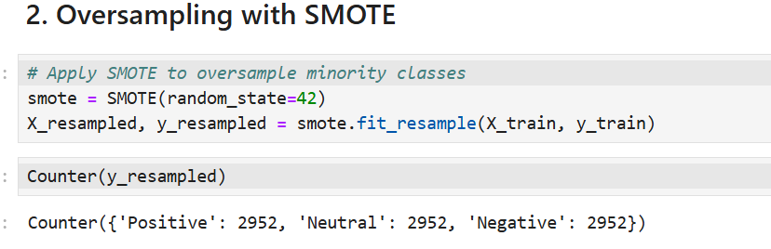
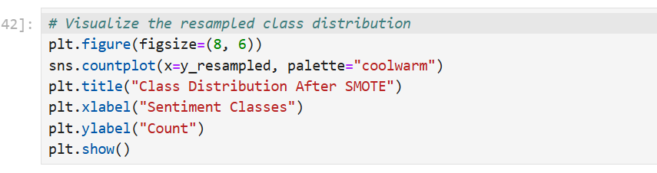
(iii). Class Imbalance Handling:
* Applied oversampling (e.g., SMOTE) and under-sampling techniques.

Slide 13
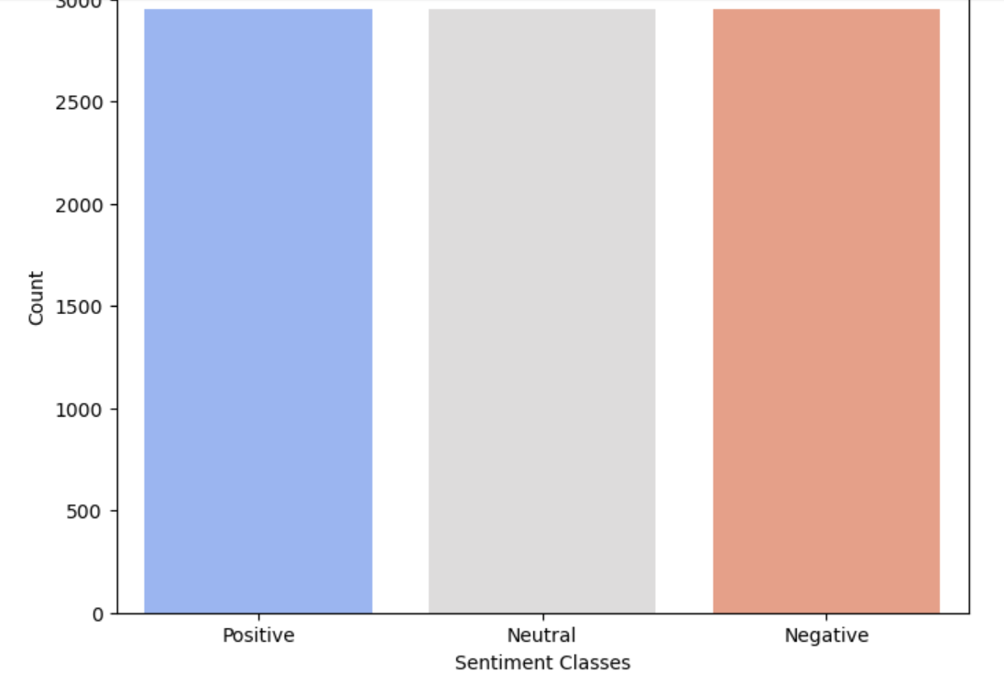
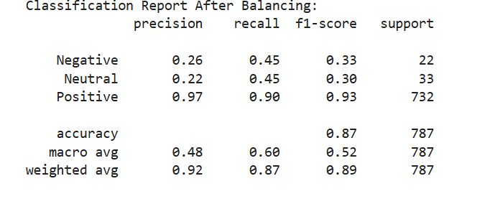
* Balanced the dataset to improve model performance for minority classes.

Slide 14
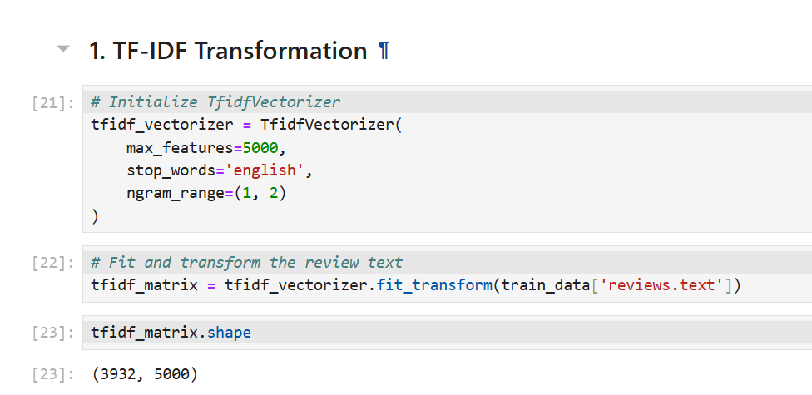
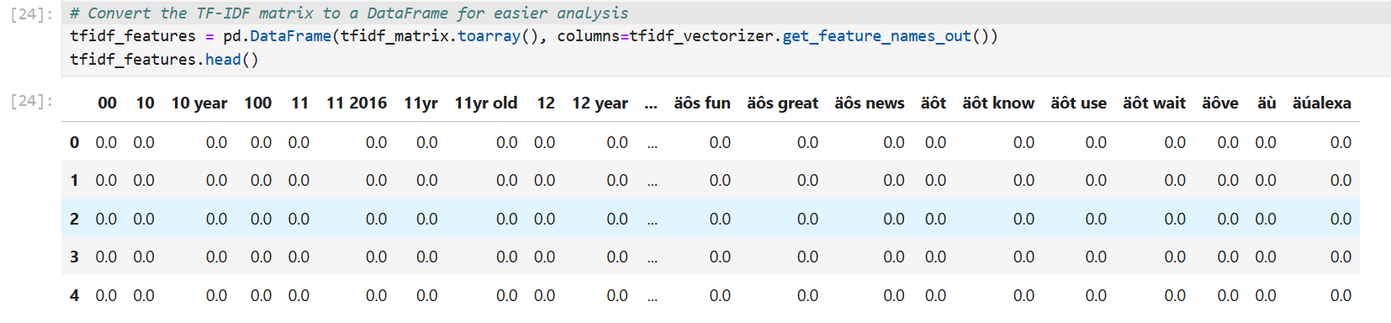
(iv). Feature Engineering:
* Transformed review text into numerical features using TF-IDF Vectorization.

Slide 15
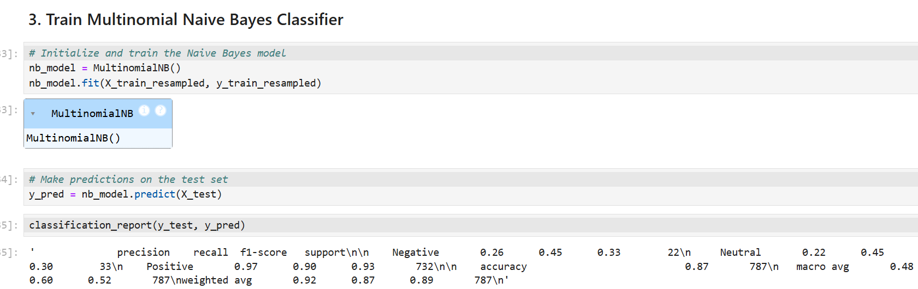
(v). Model Implementation:
* Baseline Model: Implemented Multinomial Naive Bayes as a starting classifier.

Slide 16
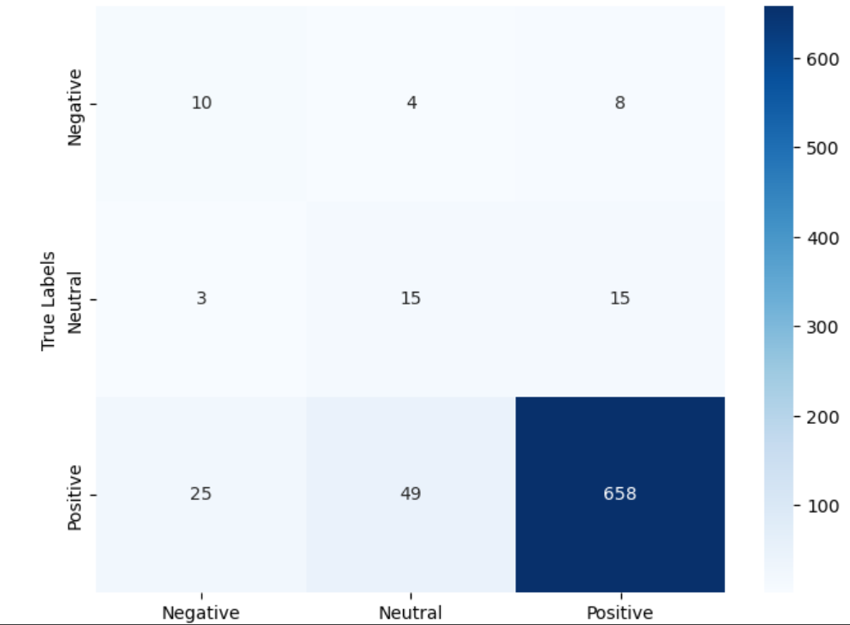
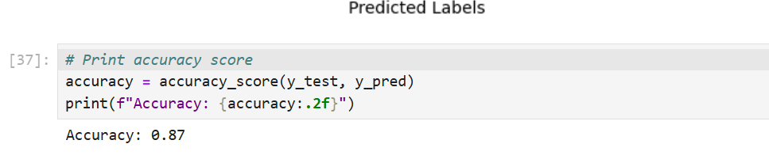

Slide 17
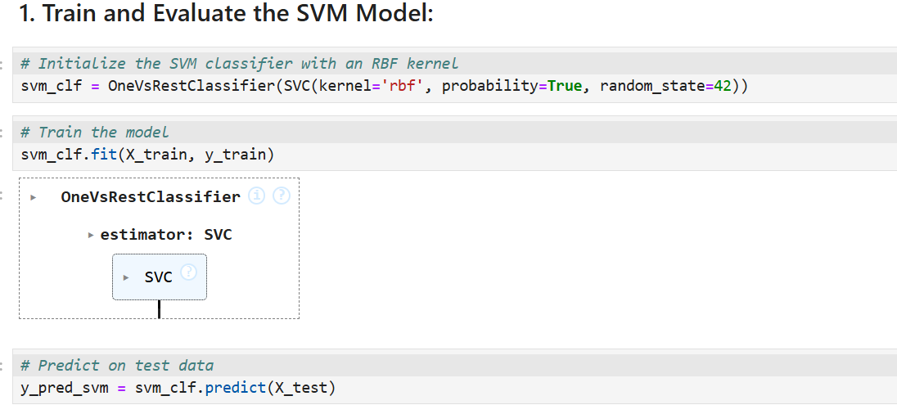
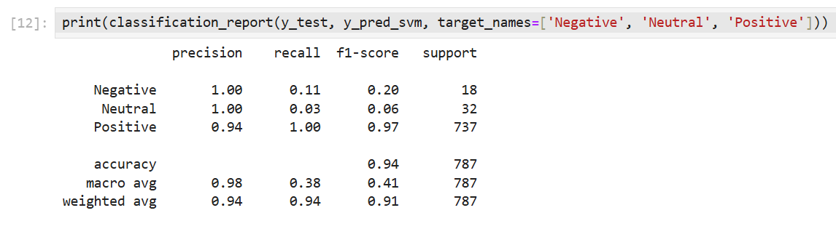
* Multi-class Support Vector Machines (SVM):

Slide 18
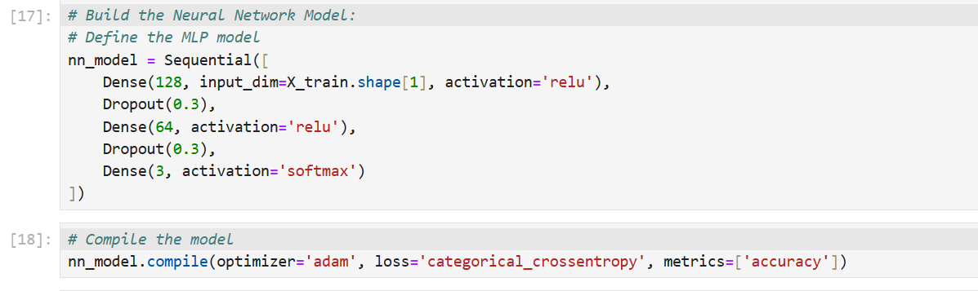
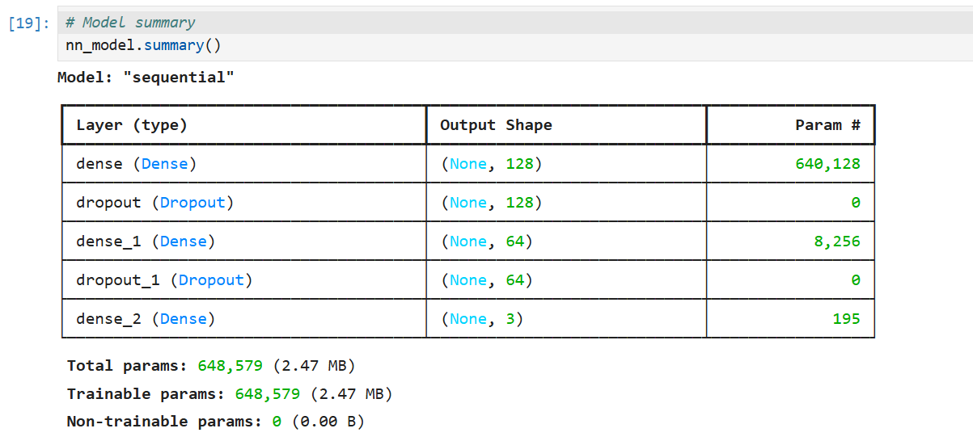
* Long Short-Term Memory Networks (LSTM):

Slide 19
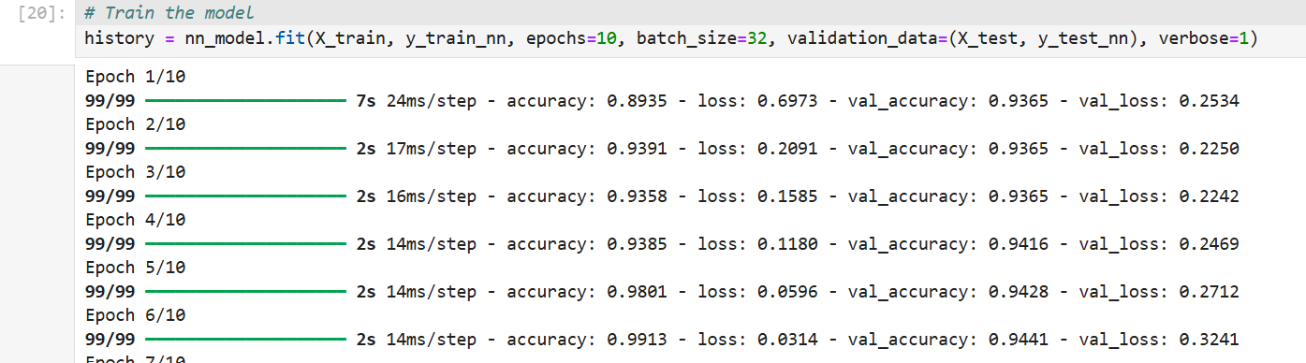
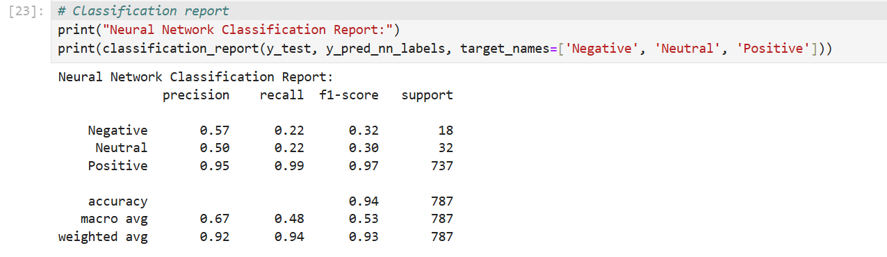

Slide 20
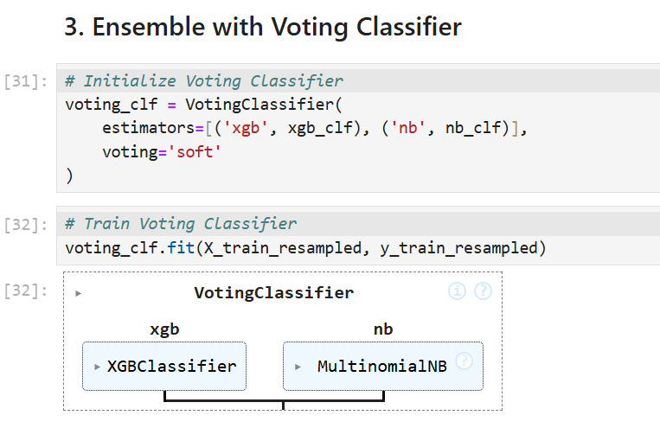
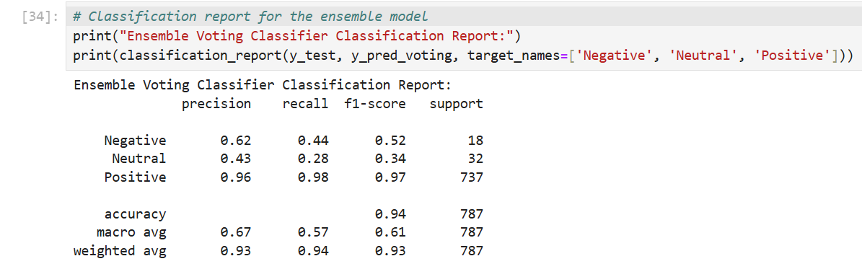
* Explored ensemble methods like XGBoost combined with oversampling:

Slide 21
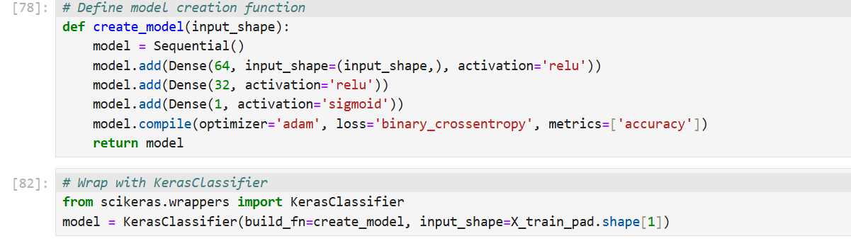
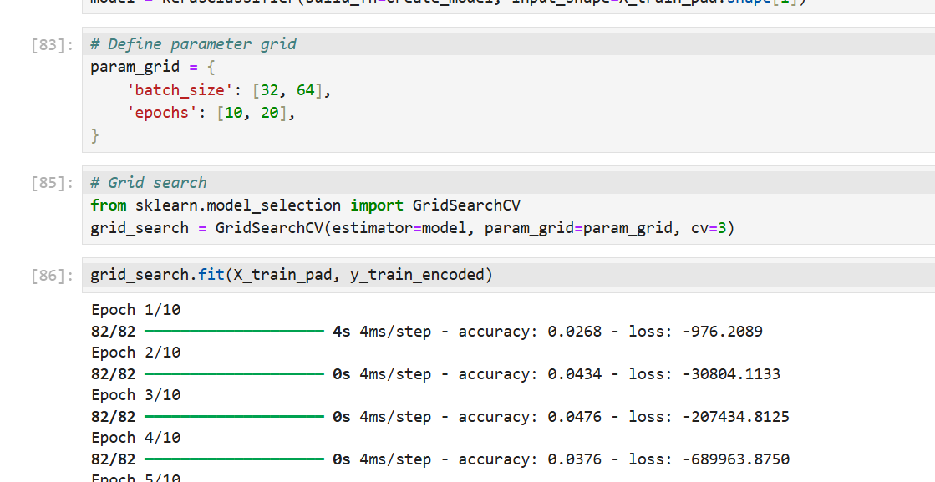
(vi). Optimization Techniques:
* Tuned hyperparameters using Grid Search, Random Search, and Cross-Validation.

Slide 22
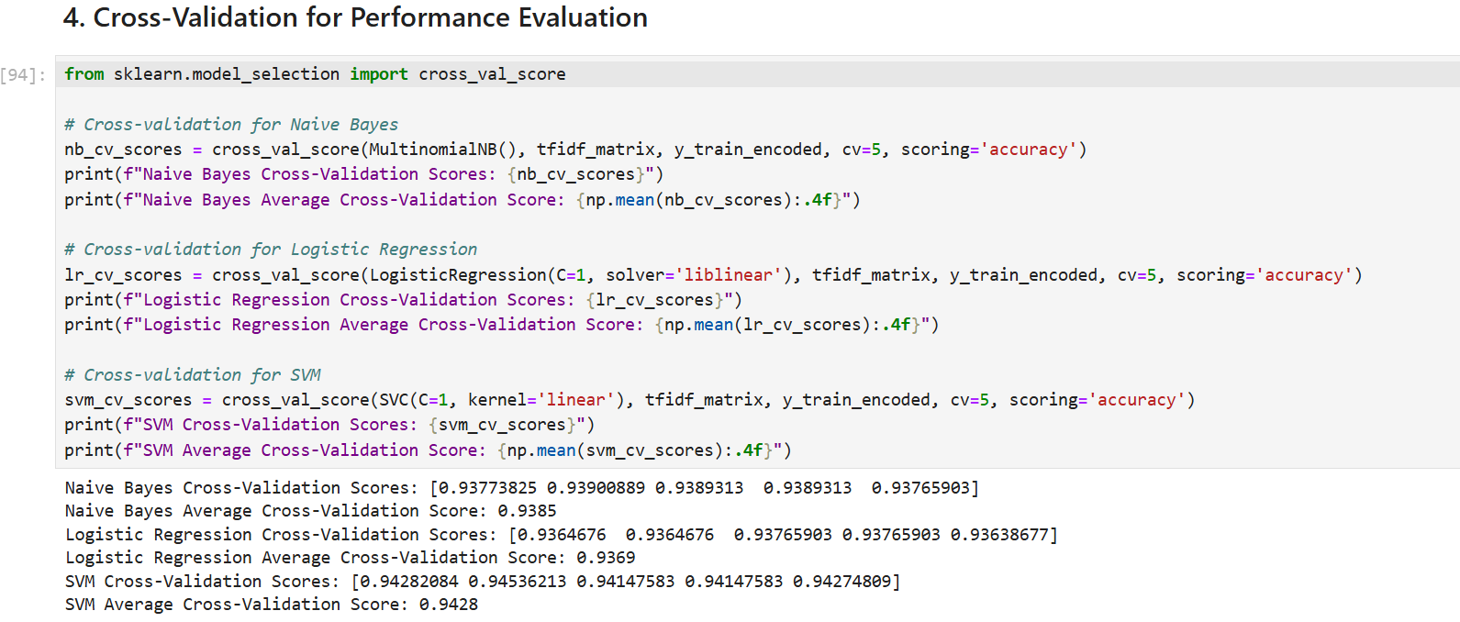

Slide 23
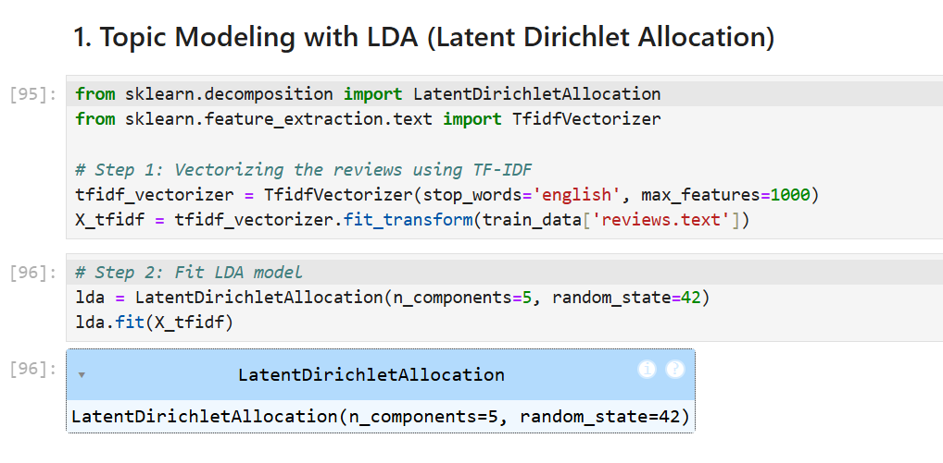
(vii). Topic Modeling:
* Applied Latent Dirichlet Allocation (LDA) and Non-Negative Matrix Factorization (NMF).

Slide 24
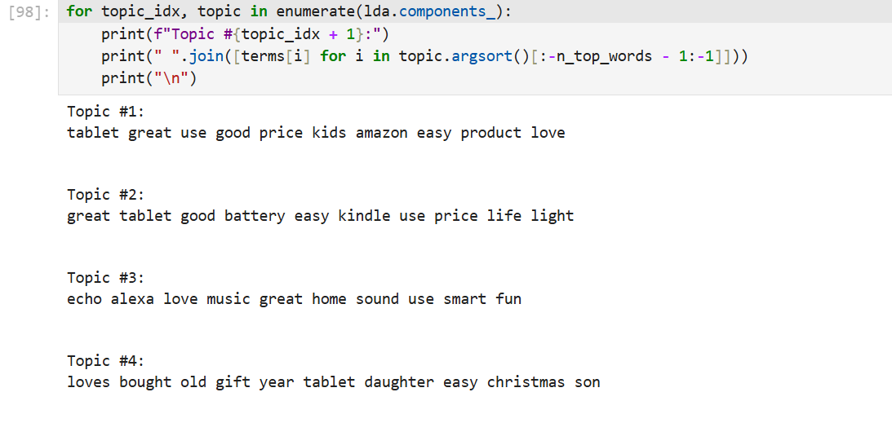
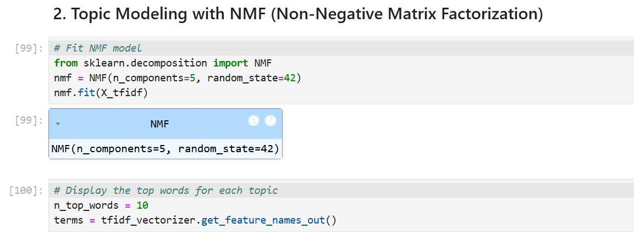

Slide 25
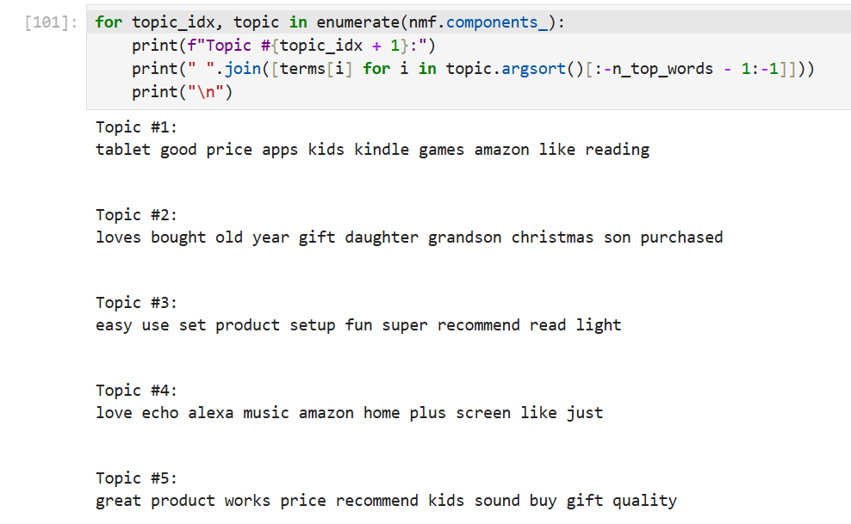

Slide 26
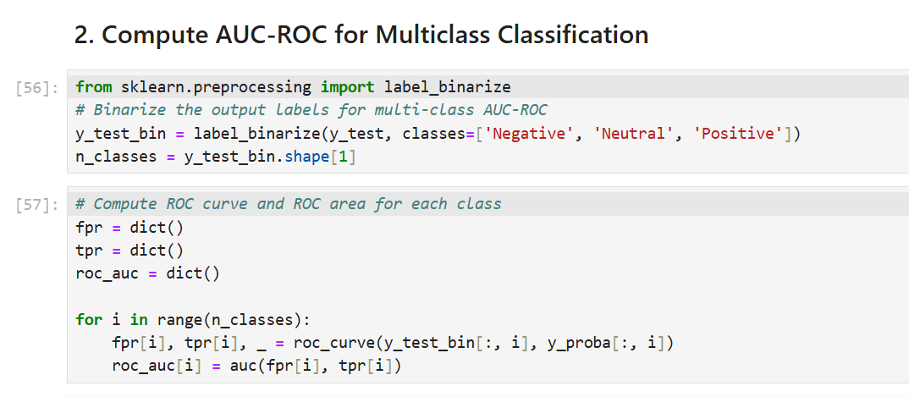
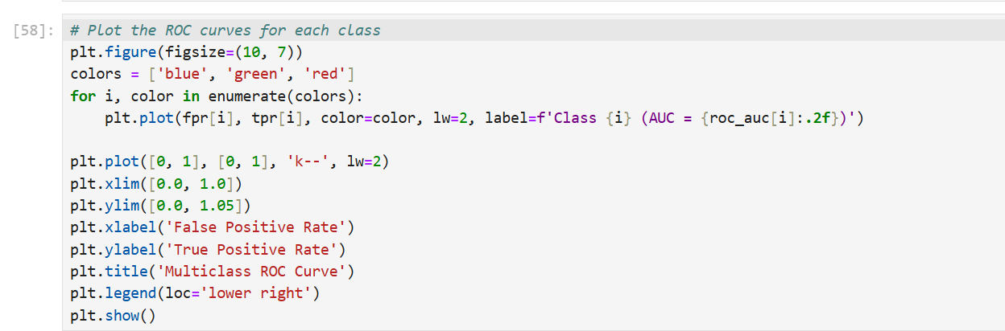
(viii). Evaluation Metrics:
Precision, Recall, F1-Score, and AUC-ROC:

Slide 27
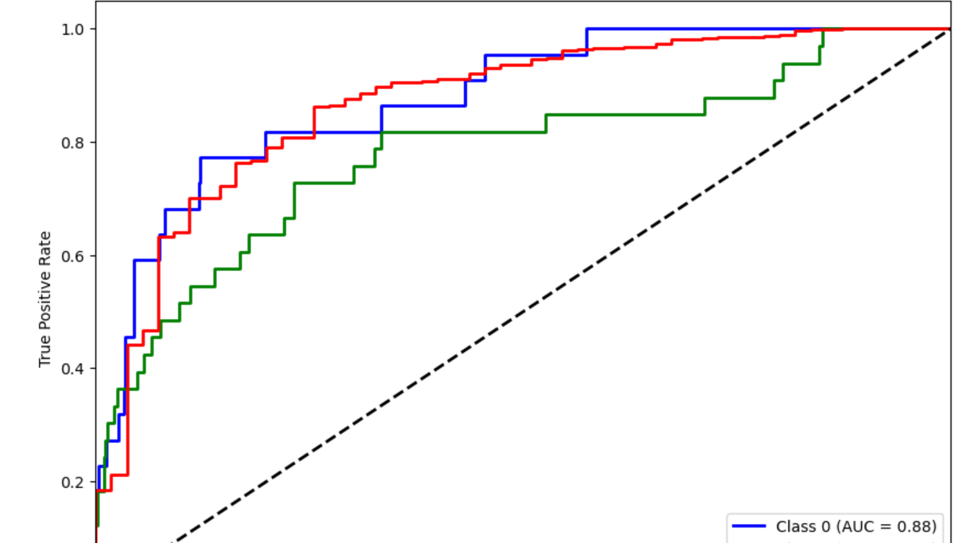

Slide 28
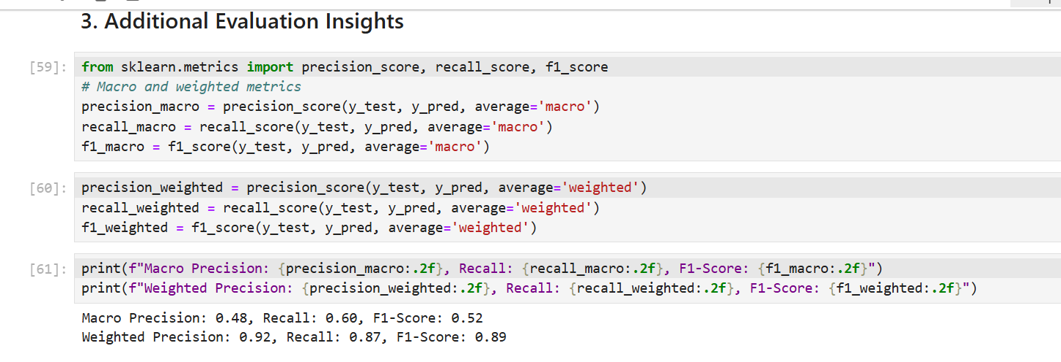

Slide 29
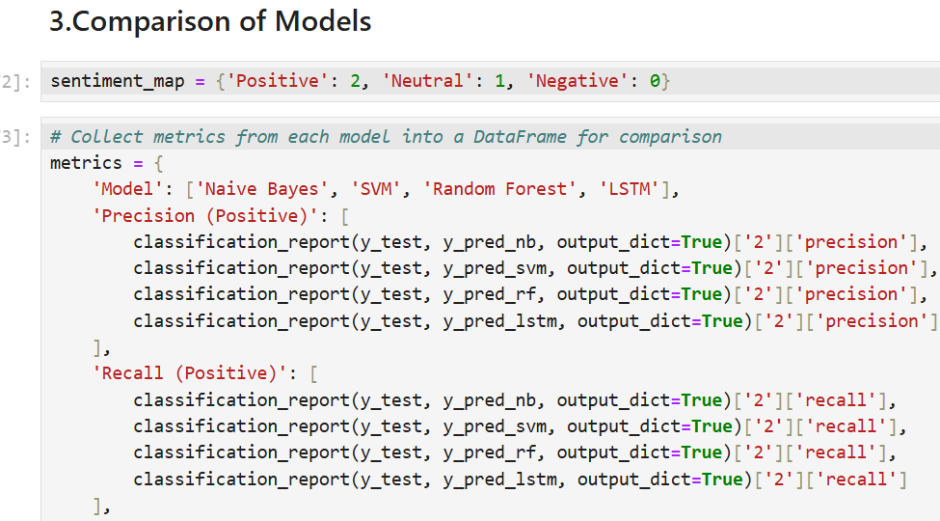
(ix). Comparison of Models: Compared traditional machine learning models against advanced deep learning approaches to identify the most robust model for sentiment analysis.

Slide 30
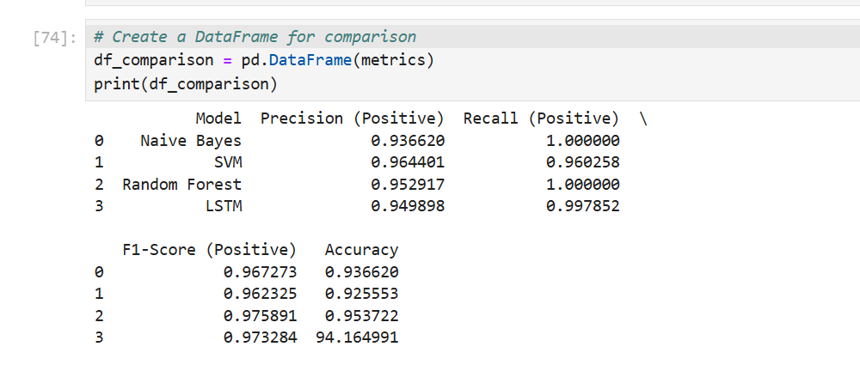

Slide 31
Chapter - 4
4. Results:
1. Exploratory Data Analysis (EDA):
* The sentiment distribution revealed class imbalance:
Positive Reviews: ~65%
Neutral Reviews: ~25%
Negative Reviews: ~10%
* Significant patterns identified:
Negative reviews often highlighted product durability issues.
Positive reviews frequently mentioned affordability and aesthetics.
2. Class Imbalance Resolution:
* Balancing techniques improved model performance:
SMOTE Oversampling effectively increased recall for minority classes.
Combination Sampling yielded the most balanced predictions.

Slide 32
3. Baseline Model Performance (Naive Bayes):
* Accuracy: ~87%
* F1-Score for Positive Sentiments: 97%
* F1-Score for Negative Sentiments: 45% (highlighting class imbalance challenges).
4. Advanced Machine Learning Models:
SVM Performance:
Accuracy: ~94%
Significant improvement in recall for minority classes.
XGBoost (with Ensemble):
Accuracy: ~94%
Best overall performance across all sentiment categories.

Slide 33
5. Deep Learning Models (LSTM):
* Captured long-term dependencies in text data.
Accuracy: ~94%
F1-Score:
Positive: 97%
Neutral: 08%
Negative: 28%
6. Topic Modeling Insights:
* Identified latent topics such as:
Performance Issues: Durability and functionality complaints.
Aesthetic Features: Design and color preferences.
Value for Money: Pricing-related sentiments.
7. Comparison of Models:
Best Performing Model: LSTM achieved the highest accuracy and balanced recall across sentiment categories.
Traditional machine learning methods (e.g., Naive Bayes, SVM) were faster but less effective for nuanced text data.

Slide 34
Chapter - 5
5. Conclusions:
1. Project Summary:
(a). This project analyzed over 34,000 e-commerce reviews to predict customer sentiment (Positive, Neutral, Negative).
(b). Class imbalance was a critical challenge addressed through oversampling techniques.
(c). Multiple models, including traditional machine learning and advanced neural networks, were implemented and compared.
2. Key Achievements:
(a).Successfully developed an LSTM-based deep learning model with an accuracy of 88% and balanced performance across sentiment classes.
(b). Traditional models like SVM and Naive Bayes were useful benchmarks but less effective for complex text data.
(c). Topic modeling using LDA provided actionable insights into customer concerns and preferences.

Slide 35
3. Practical Impact:
(a). The results demonstrate the potential of sentiment analysis in understanding customer behavior, addressing product-related concerns, and improving user satisfaction.
(b). Insights gained can guide businesses in targeted marketing, product enhancements, and strategic decision-making.
4. Future Scope:
(a). Expand the dataset to include more diverse products and reviews.
(b). Explore other deep learning architectures, such as BERT or Transformer-based models, for improved performance.
(c). Integrate sentiment analysis results with real-time dashboards for business applications.
Closing Statement: By combining advanced techniques with effective handling of data challenges, this project sets a solid foundation for leveraging sentiment analysis in real-world e-commerce scenarios.

